Slide 1
Backend driven NLP prototype
USING ANGULAR AND CORDOVA FRONT END AND C# BACKEND

Slide 2
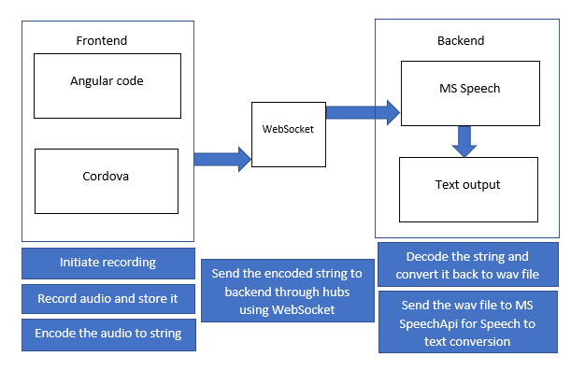
BLUEPRINT OF THE APPLICATION
BASE 64 ENCODED STRING
RECOGNIZED TEXT

Slide 3
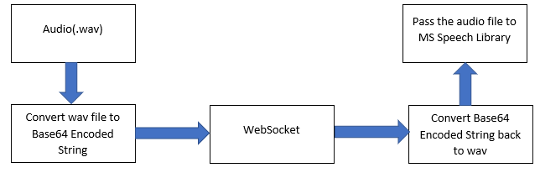
PROCESSING OF THE AUDIO FILE

Slide 4
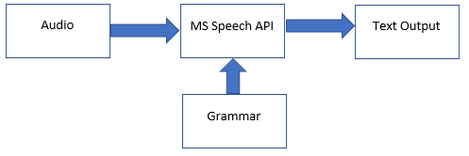
WORKING OF SPEECH RECOGNITION

Slide 5
FUTURE SCOPE
ADDING A TRIGGER WORD TO AVOID UNNECESSARY SPEECH PROCESSING
STREAM BASED RECORDING AND PROCESSING

Slide 6
THANK YOU

